Slide 1

Welcome back!
Studio S8
Ma Chi Kin Brian
e1121386@u.nus.edu
Tele: @bmanara

Slide 2
How was your midterms?

Slide 3
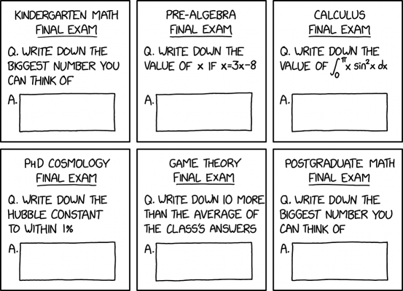
Midterms…
Hope everyone did alright!
And even if you feel like you did badly, it’s ok!
Notes:
Emphasize these points:
I’m sure all of you tried your best, and that’s all that matters.
This is a good time to think about what we truly want to get out of our University experience here in NUS.
Am I here just for grades? Good GPA?
Or am I here to just learn and do my best?
A good university experience > grades?
So don’t stress over exams! Once it’s over, look ahead!
If worried, feel free to drop a msg! (Again, the CS1101S team is here to help!)

Slide 4
Agenda for Today
Admin Matters
Really Quick Recap
Robot Mission!!! (No worksheet today wooo)

Slide 5
Admin Matters
Robotic Missions (and Quests)
Robotic Trials: To be completed and graded today!
Moving about on Planet Y
Finding Eldric
PID Stop (Quest)
Find a meeting time as a studio to meet up and complete the missions!
Sumobot Competition
Sign up if you are interested!

Slide 6
REALLY
QUICK
RECAP
State
Mutable Data
Arrays
Loops
Notes:
*not important/assessed

Slide 7
Functional Programming
Everything we have learned in Unit 2 has been…
Functional. Our computation is functional
Our functions always return the same result as long as they are given the same arguments
Memoryless/stateless
Each function call is independent of the past, and of the future
Doing so makes it easy to reason with the program
Substitution Model works well

Slide 8
State
But what if we want our functions to return different results (even when same argument is given) based on the state of our program?
Example (given in lecture):
withdraw(20) function should
return balance if there is sufficient funds,
else display error
We can implement this using Assignment or Functional Approach.

Slide 9
State
Variable Declaration Statement:
let name = expression;
Note that from Source 3 onwards, function parameters are variables.
Assignment Statement:
name = expression;
expression is evaluated, then its value is assigned to the variable name

Slide 10
State (Pros & Cons)
Pros:
Allows us to create objects with state
State allows our objects to behave differently over time
Cons:
Harder to reason with our programs
Harder to debug
Harder to verify/prove correctness
Substitution Model does not work anymore…
Introducing, the CSE Machine (more on that next week)

Slide 11
Mutable Data
Assignment allows us to create mutable data.
In Source 1 and 2, all our data was immutable.
Think back to our LISTS functions… We never actually made any changes to the list itself!

Slide 12
Mutable Data
Mutable Pairs:
mutators are now introduced to create mutable data structures
For our pairs:
set_head(p, x)
set_tail(p, x)
But, be careful with mutators!

Slide 13
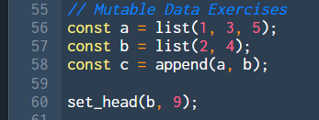
Exercises
What is c after I run this?
Notes:
Intuitively, sort the tail of the list first, then find the spot where the head belongs in the sorted list.

Slide 14
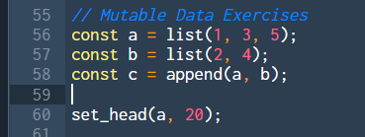
Exercises
What is c after I run this?
Notes:
Intuitively, sort the tail of the list first, then find the spot where the head belongs in the sorted list.

Slide 15
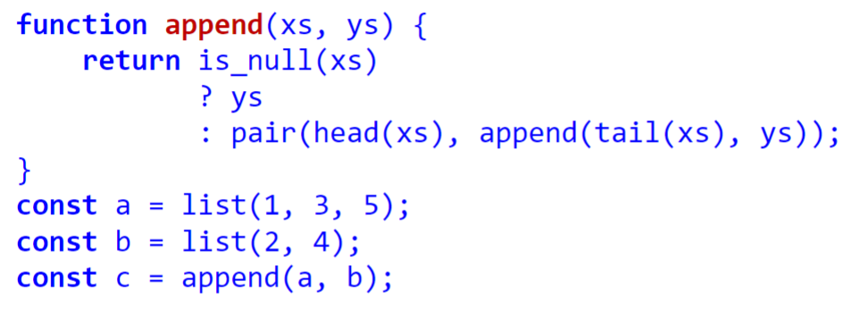
Recall: Implementation of Append

Slide 16
“Destructive” Methods
d_append(xs, ys)
Uses set_tail to combine the two lists
Reuses both xs and ys
d_map(f, xs)
Uses set_head to change the values
Does not create a new list! (Unlike our old implementation of map)
Notes:
Intuitively, find the smallest element and put it at the front. Sort the rest of the list without the smallest element recursively.

Slide 17
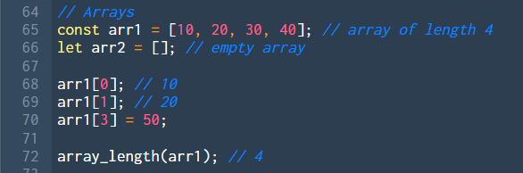
Arrays
A data structure that stores a sequence of data elements.

Slide 18
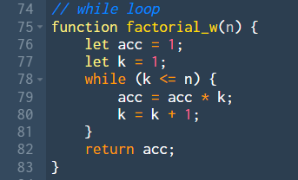
while Loop
Keeps looping until predicate returns false…

Slide 19
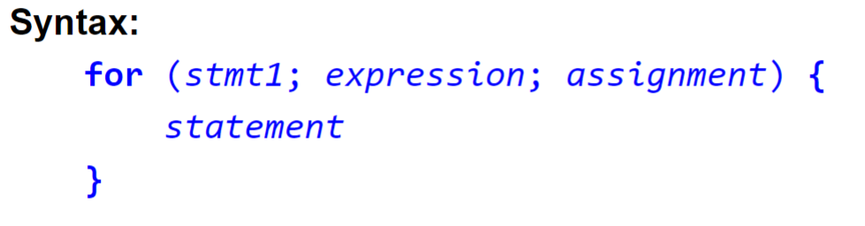
for Loop
stmt1:
An assignment statement OR
A variable declaration statement (loop control variable)

Slide 20
for Loop
expression:
Predicate that returns true or false
Determines whether we continue looping

Slide 21
for Loop
assignment:
Usually used to update our loop control variable

Slide 22
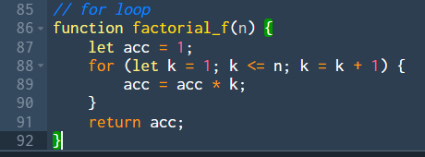
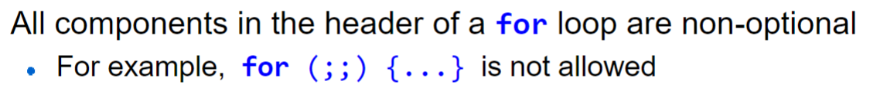
for Loop
Example:

Slide 23
break; continue;
break keyword
Terminates the current iteration, AND
Terminates the entire loop
continue keyword
Terminates the current iteration
Continues with the loop
Notes:
Examples in Source

Slide 24
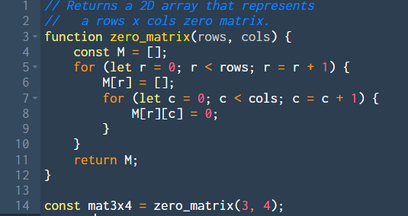
Arrays & Loops
Now, we can do things like this!
Order of Growth?

Slide 25
Arrays & Loops
Now, we can do things like this!
Order of Growth:
O(r*c)

Slide 26
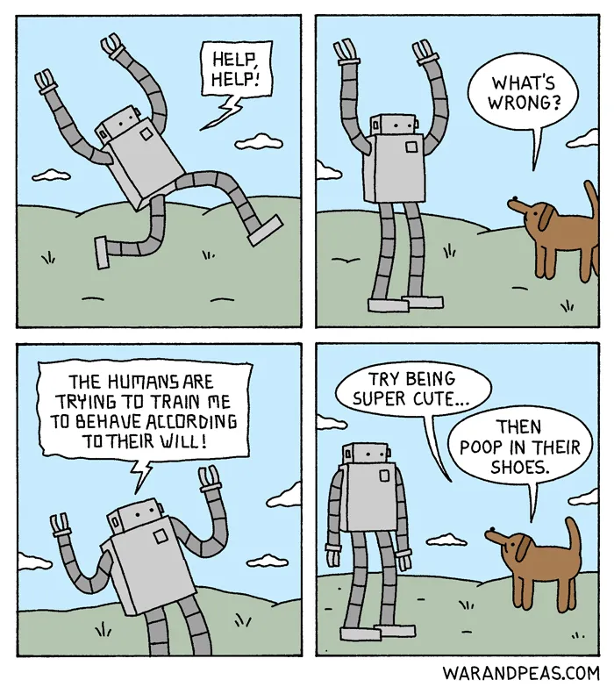
Robot Time

